Slide 1
MLFQ Simulation
Ishan Tyagi, Ron Zatkovsky, Richard Seecharran, Eric Lin
Notes:
Richard Slides 1-8, FIFO if undertime
For our CSE 4300 group project we decided on building a MLFQ simulation.
In our group we have Ishan, Ron, Eric and myself Richard

Slide 2
Objectives
Implement MLFQ and compare it to other schedulers, for that we need:
MLFQ: Multiple queues, Aging, Preemption, Priority, IO
MLQ: Multiple queues, every queue different scheduler, IO
SJF: know how long it takes to complete a job, when it arrives
RR: arrival time, timeslice (quantum), IO handle
SRTF: know when job is supposed to finish or know how long it runs, and when arrives
FIFO: arrival time
Notes:
Note we did all of this in C++

Slide 3
What is MLFQ?
MLFQ is a scheduling algorithm in operating systems for managing process execution.
It organizes multiple queues, each representing different priority levels.
Processes are sorted into queues based on computational needs and behavior.
Priorities are dynamic, with feedback used to promote or demote processes between queues.
The goal is to balance quick turnaround for short jobs and responsiveness for interactive ones.

Slide 4
Our Implementation
This project was broken down into:
Process Class
MLFQ Class
Test with simulation

Slide 5
Process Class
This class provides the structure for MLFQ and other schedulers
Allowing for managing individual process, their jobs, and states
Example
Process p1("Process 1", 5, {{20, "CPU"}, {10, "IO"}});
Functions
addJobs(), getCurJobType(), getCurJobTime(), decrementJobTime(), removeCurJob(), printDetails()
Notes:
This example shows how we used the process class in the end with their being a process called p1 with a name, arrival time and jobs attribute where the 20 and 10 are burst times with their associated type
Processes are sorted into queues based on computational needs and behavior. So to do this we created these functions to help differentiate need attributes for when we do the computation logic in the MLFQ class

Slide 6
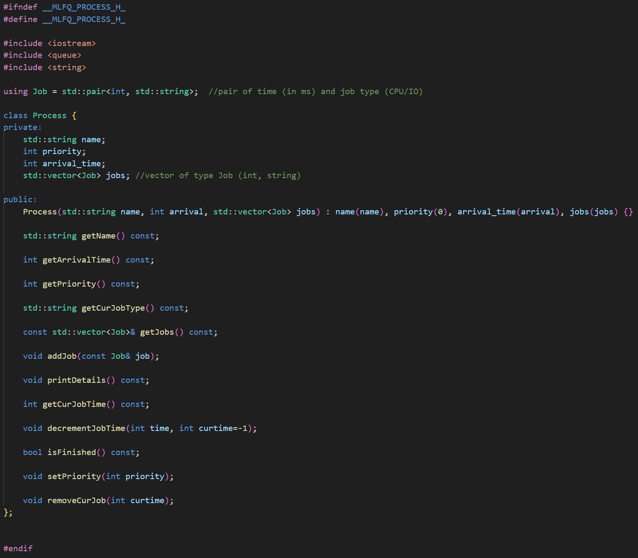
Process Class Implementation (MLFQ_process.h)
Header file: MLFQ_process.h
Notes:
This slide shows what the process class implementation header file will look like, so in MLFQ_process.h we have these header file library includes, we have this pair called job which includes two elements a int and a string which will be assigned the burst time in ms and the job type either CPU or IO.
In the process class we have these attributes string name, int priority, int arrival_time and a vector of type Job which has that same (int, string) format.
In public we have the constructor that was mentioned in the previous slide example with the name, arrival time and jobs vector. We also set the priority here to 0 but it gets changed later on in our implementation. Also in the public we have a bunch of functions..which are all functions we thought were necessary to help us implement the MLFQ and other schedulers.

Slide 7
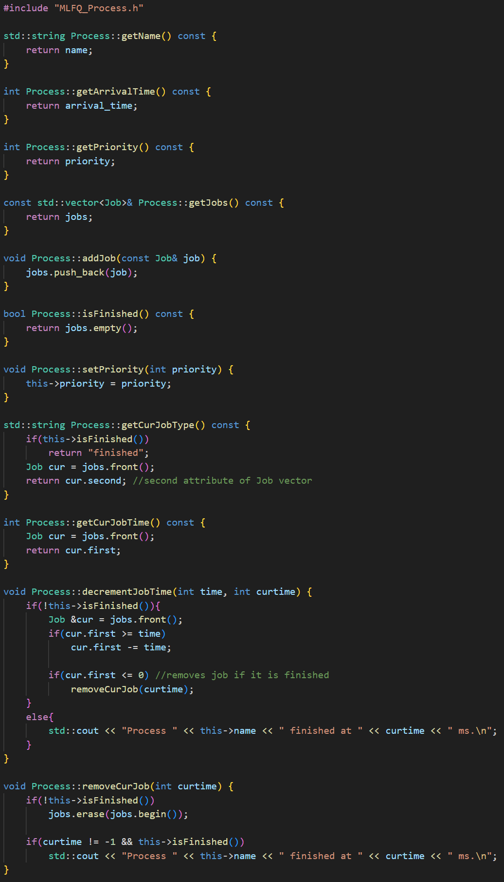
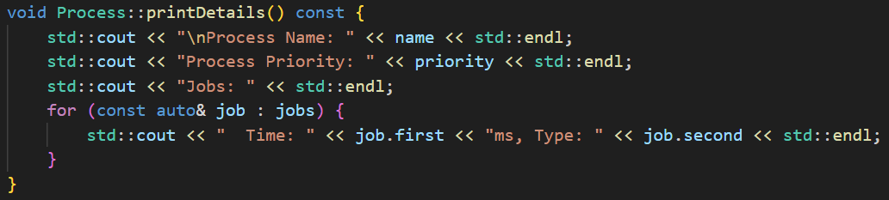
Process Class Implementation
(MLFQ_process.cpp)
MLFQ_process.cpp
Notes:
Explain C++ lingo → i.e push_back

Slide 8
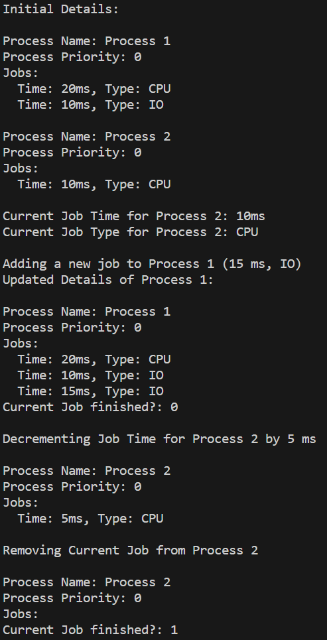
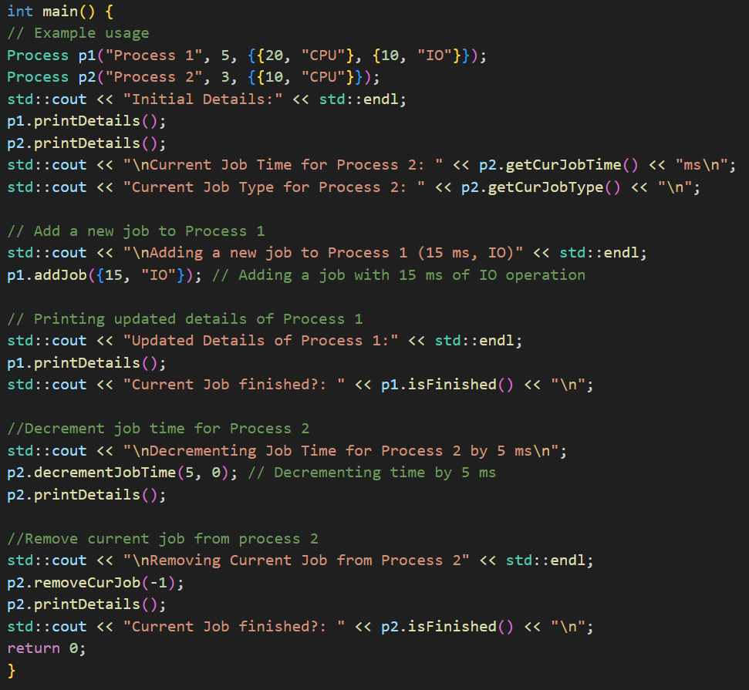
Process Class Testing

Slide 9
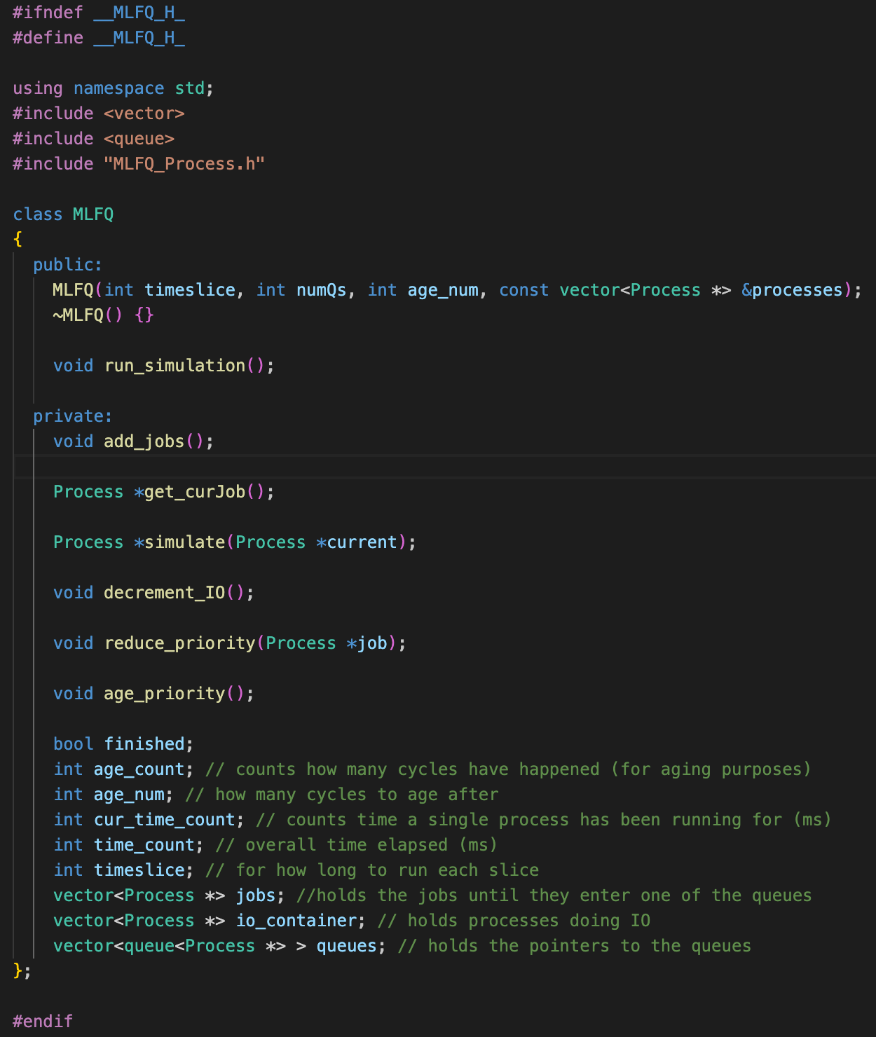
MLFQ Implementation
Header file: MLFQ.h

Slide 10
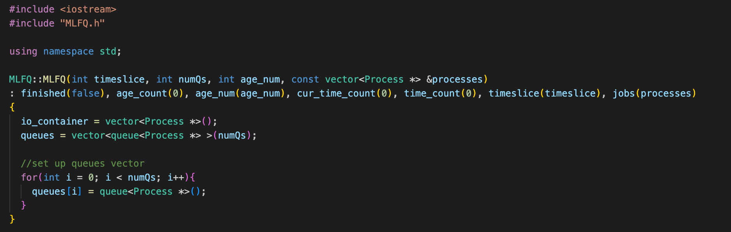
MLFQ Implementation ( MLFQ.cpp )

Slide 11
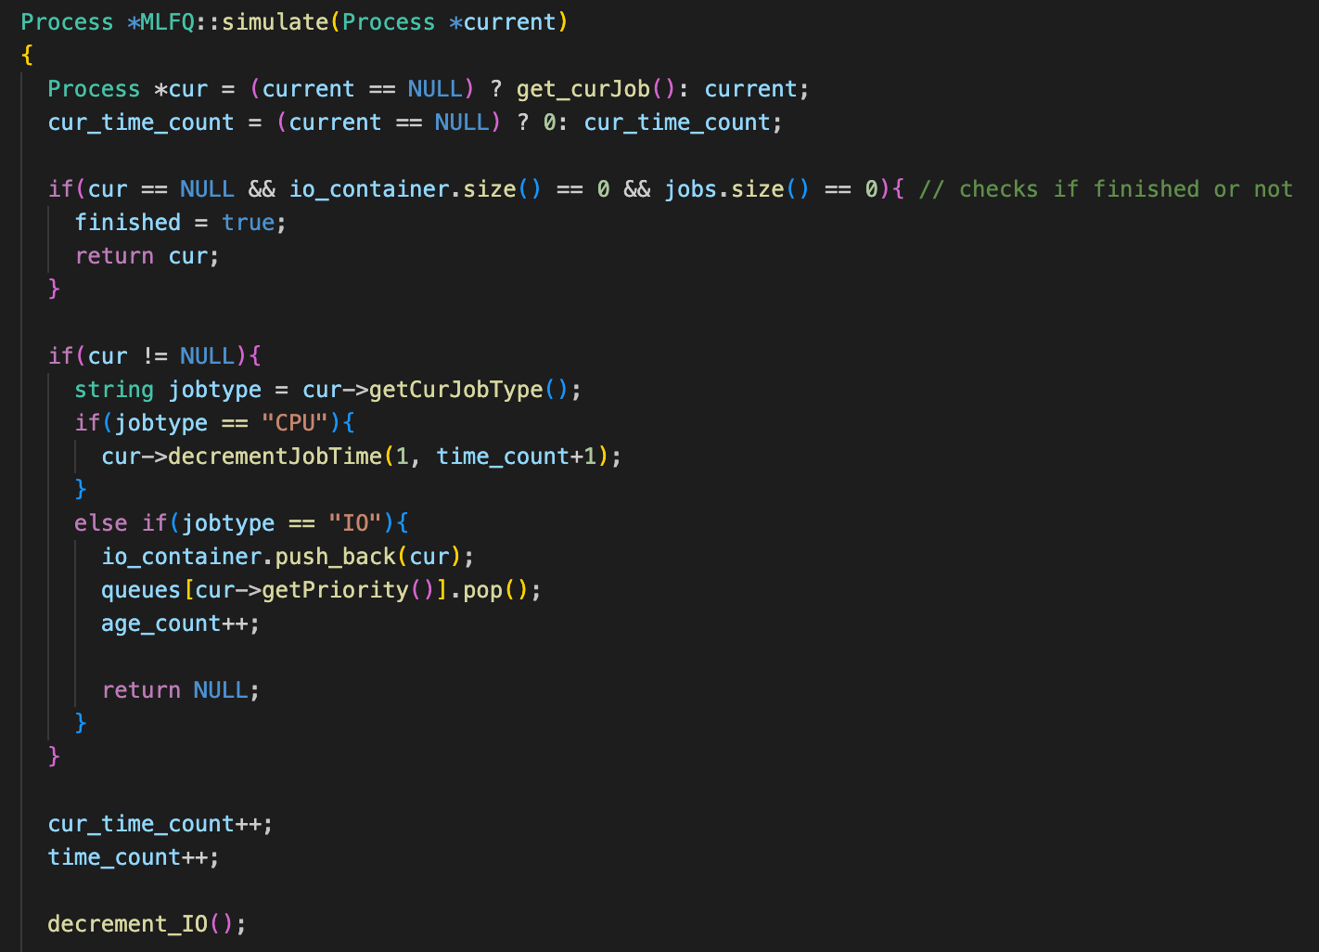
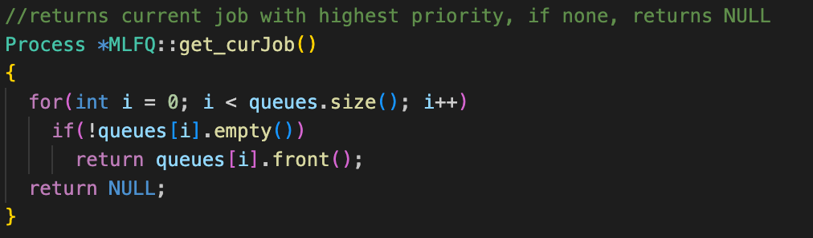
MLFQ Implementation ( MLFQ.cpp : simulate )

Slide 12
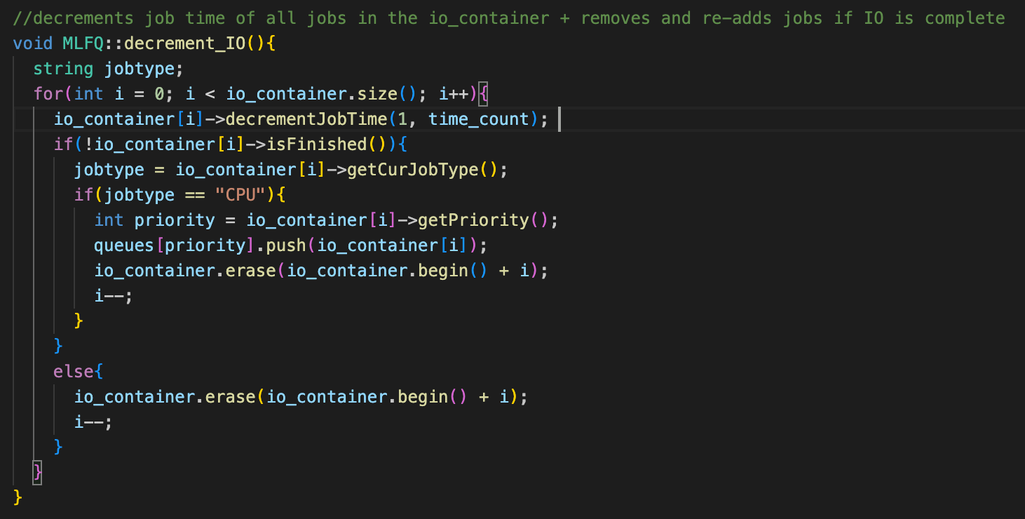
MLFQ Implementation ( MLFQ.cpp )

Slide 13
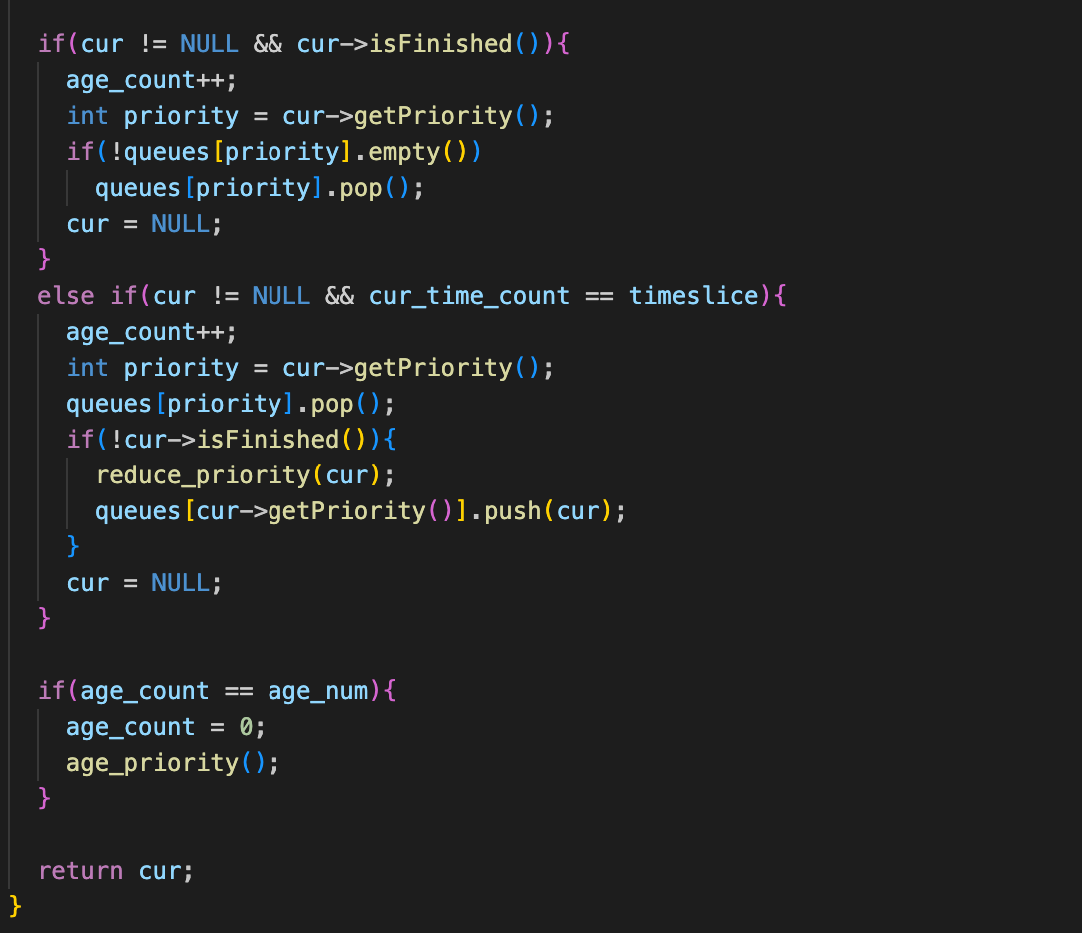
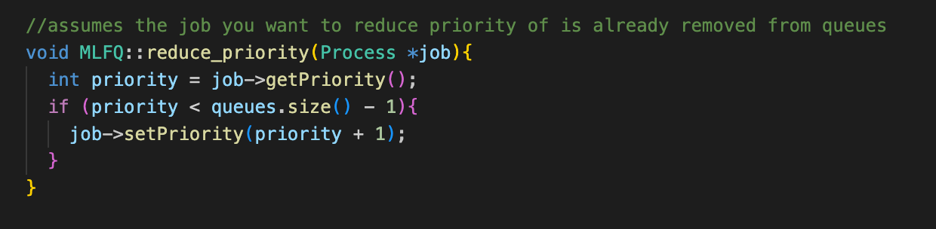
MLFQ Implementation ( MLFQ.cpp )

Slide 14
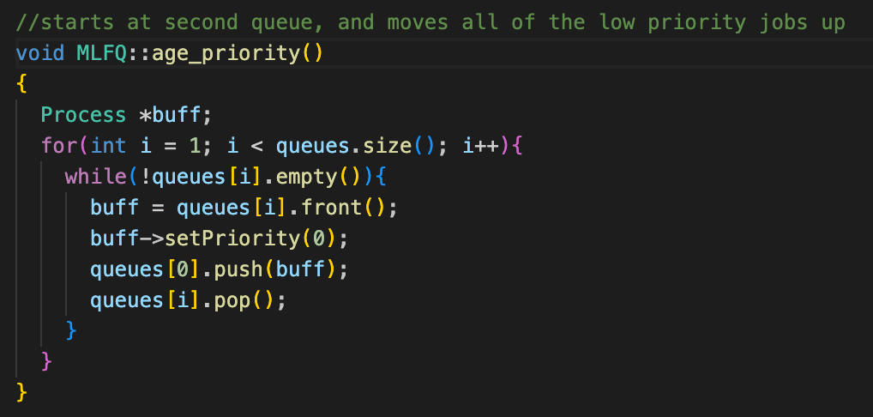
MLFQ Implementation ( MLFQ.cpp )

Slide 15
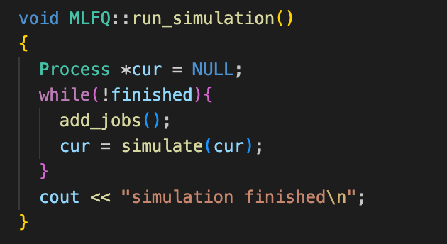
MLFQ Implementation ( MLFQ.cpp )

Slide 16
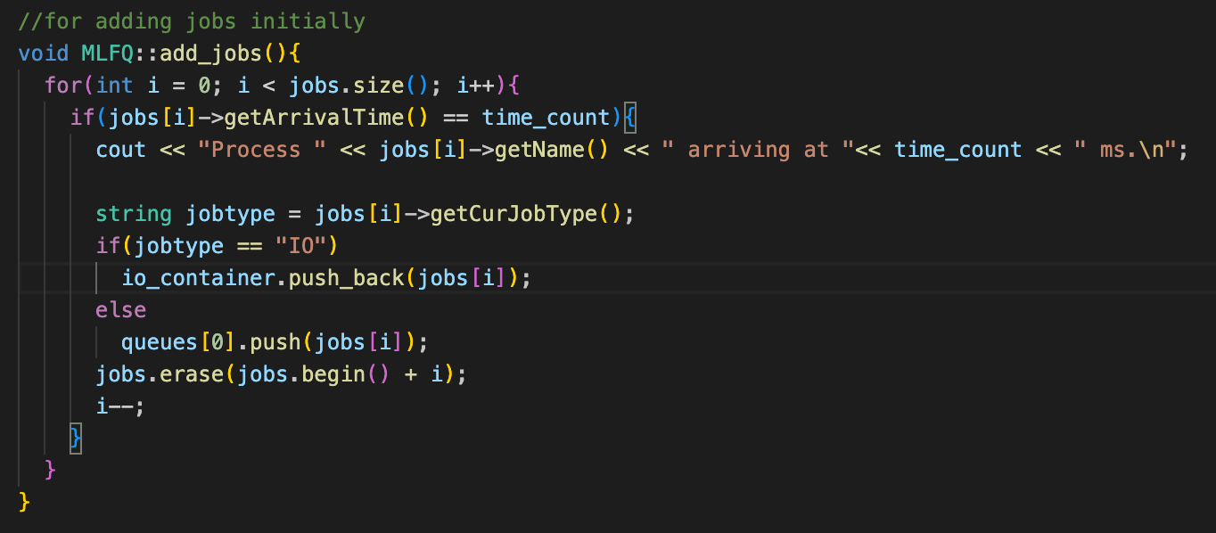
MLFQ Implementation ( MLFQ.cpp )

Slide 17
MLFQ test run-through example
Process 1 arrives at 0 with Jobs: {10, CPU}
Process 2 arrives at 0 with Jobs: {3, CPU}, {2, IO}, {3, CPU}
Process 3 arrives at 0 with Jobs: {4, CPU}, {2, IO}, {4, CPU}
Q1 |  |  |  |  |  | 1 | 1 | 1 | 1 | 1 | 1 | aged
Q0 | 3 2 1 | 3 2 1 | 3 2 1 | 3 2 1 | 3 2 1 | 3 2 | 3 2 | 3 2 | 3 | 3 | 2 3 | 1 2
cpu | 1(1) | 1(2) | 1(3) | 1(4) | 1(5) | 2(1) | 2(2) | 2(3) | 3(1) | 3(2) | 3(3) | 3(4)
time | 1 | 2 | 3 | 4 | 5 | 6 | 7 | 8 | 9 | 10 | 11 | 12
age | 0 | 0 | 0 | 0 | 1 | 1 | 1 | 2 | 2 | 2 | 2 | 3
IO |  |  |  |  |  |  |  | P2(2) | 1 | 2 |  | P3(2)

Slide 18
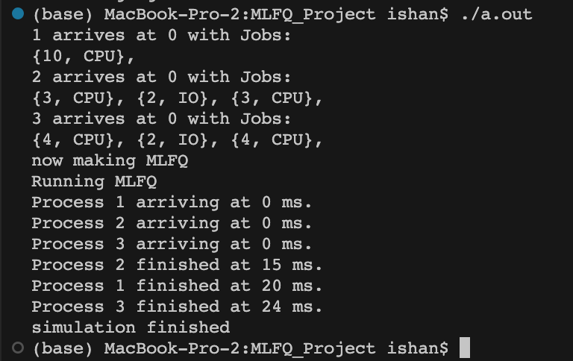
MLFQ test run-through example output
Process 1 arrives at 0 with Jobs: {10, CPU}
Process 2 arrives at 0 with Jobs: {3, CPU}, {2, IO}, {3, CPU}
Process 3 arrives at 0 with Jobs: {4, CPU}, {2, IO}, {4, CPU}

Slide 19
Continue MLFQ…
Q1
Q0 | 1 | 1 | 3 1 | 3 1 | 3 1 | 3 1 | 3 1 | 3 1 | 3 | 3 | 3 | 3
Cpu | 2(1) | 2(2) | 2(3) | 1(6) | 1(7) | 1(8) | 1(9) | 1(10) | 3(1) | 3(2) | 3(3) | 3(4)
time | 13 | 14 | 15 | 16 | 17 | 18 | 19 | 20 | 21 | 22 | 23 | 24
age | 0 | 0 | 1 | 1 | 1 | 1 | 1 | 2 | 2 | 2 | 2 | 3
IO | 1 | 2 |  |  |  |  |  | P2(2) | 1 | 2

Slide 20
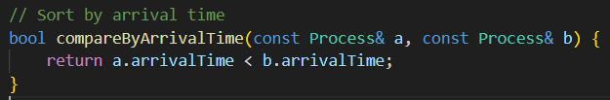
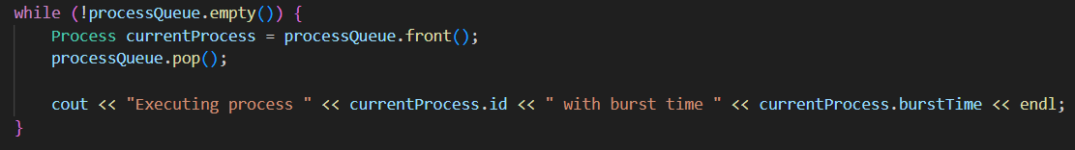
First In First Out (FIFO)
The first process that arrives is the first one to be executed.
Processes are executed in the order they enter the queue.
Idea: Sort the arrival time from earliest to latest
Earliest = front of queue
Latest = end of queue
Execution: process at front
Completion: remove the process at the front
Next process in line will start executing

Slide 21
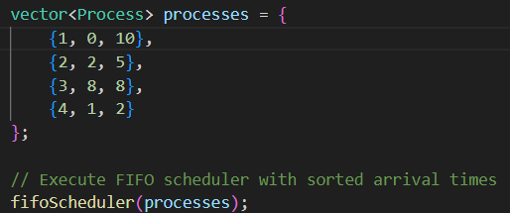
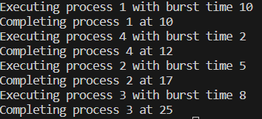
Demo of FIFO
Process | Arrival Time | Burst Time | Completion Time | Turn Around Time | Waiting Time
1 | 0 | 10 | 10 | 10 | 0
2 | 2 | 5 | 17 | 15 | 10
3 | 8 | 8 | 25 | 17 | 9
4 | 1 | 2 | 12 | 11 | 9

Slide 22
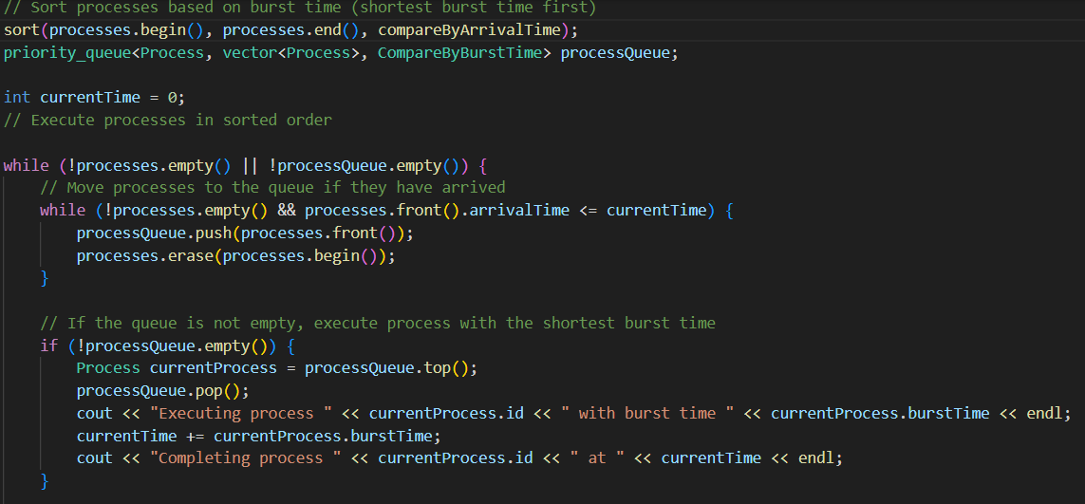
Shortest Job First (SJF)
The process with the shortest burst time will be ran first.
Processes are executed in the order of their burst time.
Idea: Sort the burst time from least to greatest.
Least = front of queue
Greatest = end of queue
Execution: process at front with the shortest burst time
Completion: remove the process with the shortest burst time
Next process in line will start executing

Slide 23
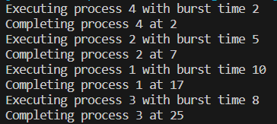
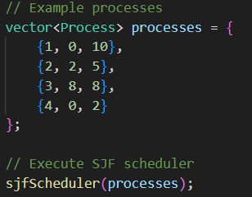
Demo of SJF
Process | Arrival Time | Burst Time | Completion Time | Turn Around Time | Waiting Time
1 | 0 | 10 | 17 | 17 | 7
2 | 2 | 5 | 7 | 5 | 0
3 | 8 | 8 | 25 | 17 | 9
4 | 0 | 2 | 2 | 2 | 0

Slide 24
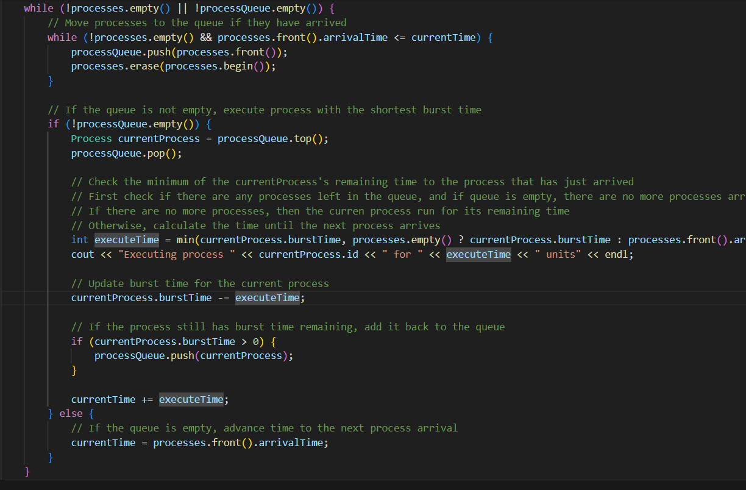
Shortest Remaining Time First (SRTF)
The process with the shortest remaining burst time will be ran first.
Processes are executed in the order of how much burst time they have remaining.
Has preemptive scheduling
Idea: Upon arrival, compare the remaining burst time to current process
Current process continues to run if BT is less than the newly arrived process
Update current process to the newly arrived process if it is less
Execution: run process, check its BT with another process, update accordingly
Completion: remove the process once BT reaches 0
Next process in line will start executing as it’s the new process with the least remaining BT
Notes:
Eric

Slide 25
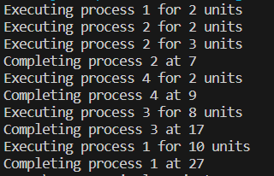
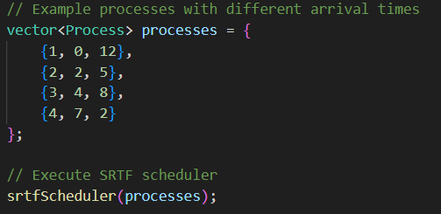
Demo of SRTF
Process | Arrival Time | Burst Time | Completion Time | Turn Around Time | Waiting Time
1 | 0 | 12 | 27 | 27 | 15
2 | 2 | 5 | 7 | 5 | 0
3 | 4 | 8 | 17 | 13 | 5
4 | 7 | 2 | 9 | 2 | 0
Notes:
Eric

Slide 26
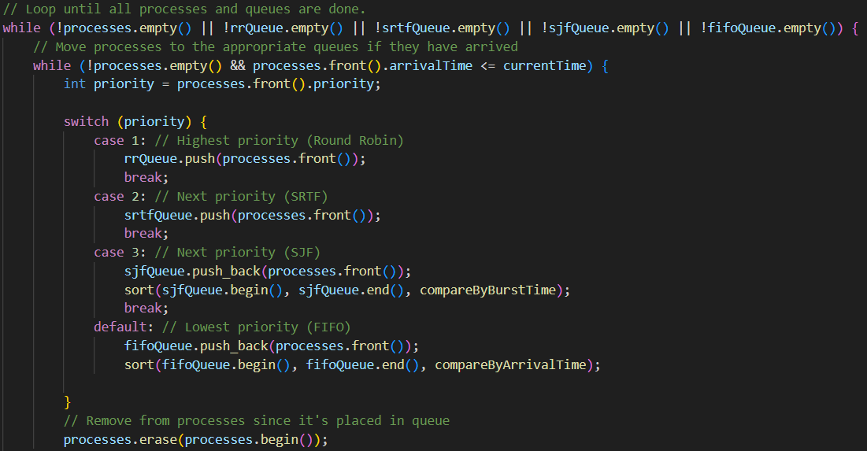
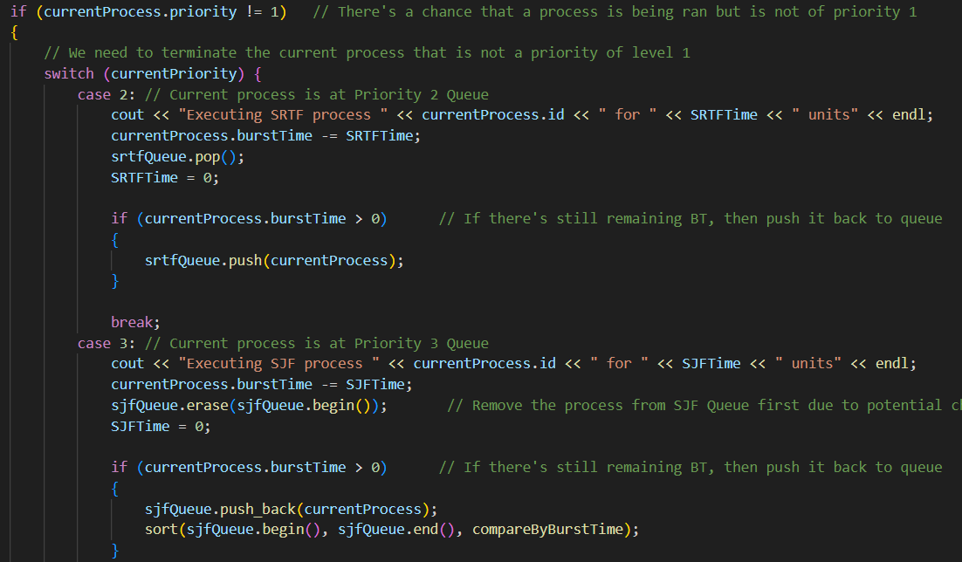
Multi-Level Queue (MLQ)
Organizes processes into multiple queues based on characteristics like burst time, priority, etc.
Hierarchy of queues
Each queues can have different algorithms
Has preemptive scheduling
Idea: Upon arrival, place process to its respective queue
Process in the higher priority queue will be ran first
If a queue is empty, go to the next queue
Execution: Run all processes on the highest priority queue
Processes are executed depending on the queue scheduling algorithm
Completion: When a process is done, move to the next process in the queue.
When all processes are done in a queue, move to the next queue.
Notes:
Eric

Slide 27
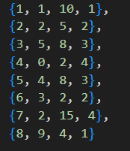
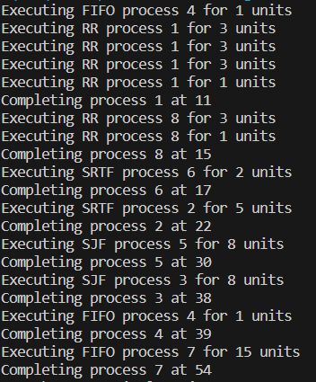
“Demo” of MLQ
Process | Arrival Time | Burst Time | Priority | Completion Time
1 | 1 | 10 | 1 | 11
2 | 2 | 5 | 2 | 22
3 | 5 | 8 | 3 | 38
4 | 0 | 2 | 4 | 39
5 | 4 | 8 | 3 | 30
6 | 3 | 2 | 2 | 17
7 | 2 | 15 | 4 | 54
8 | 9 | 4 | 1 | 15
Notes:
Eric

Slide 28
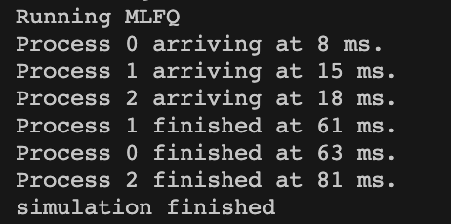
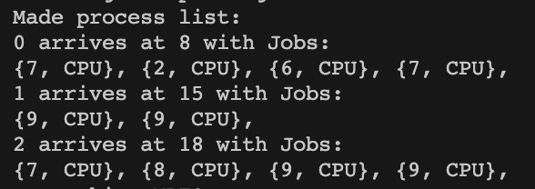
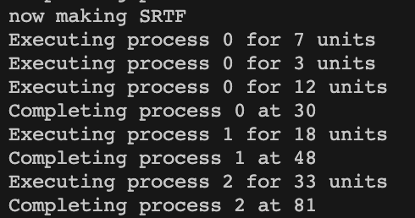
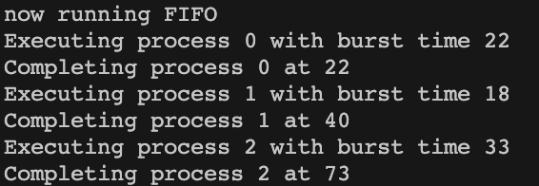
Some Comparison + Results
FIFO: Shortest Remaining Time First:

Slide 29
Any Questions?
Thank you!!

